Slide 1
KP Upgrade Endpoints & Airdroid addition
Detailed Scoping

Slide 2
Add apk to Koko Core (Already Exists)
Process
Database
Create a Release groupçç
Select KP/STS/SDS/AIRDROID aPK
Create group id
Table name - apk_releases
created
updated
id
apk
apk_name
apk_hash
apk_size
version_name
version_x
version_y
Verison_z
group_id
Select APK to install
Decide the installation time
Select release group
Select APk
Endpoint
/admin/apk/create

Slide 3
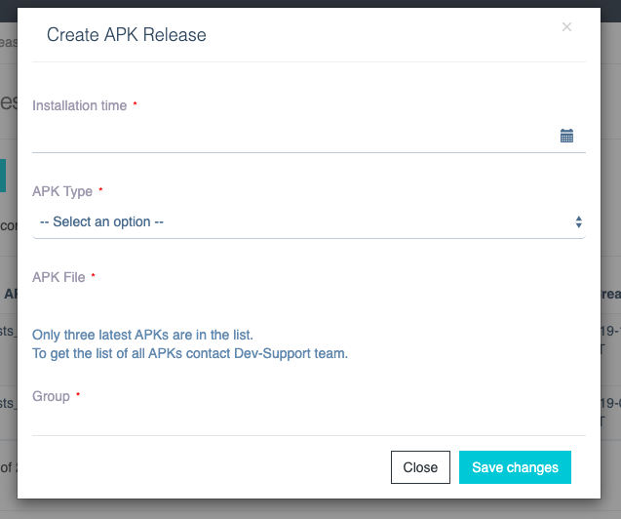
Add APK

Slide 4
Delete apk from Koko Core(Already Exists)
Endpoint
/admin/apk/delete

Slide 5
New Apk name format
Previous format
<app_type>-<version_name>-<git_branch>.apk
New format
<app_type>-<version_name>-<version_code>-<git_branch>.apk

Slide 6
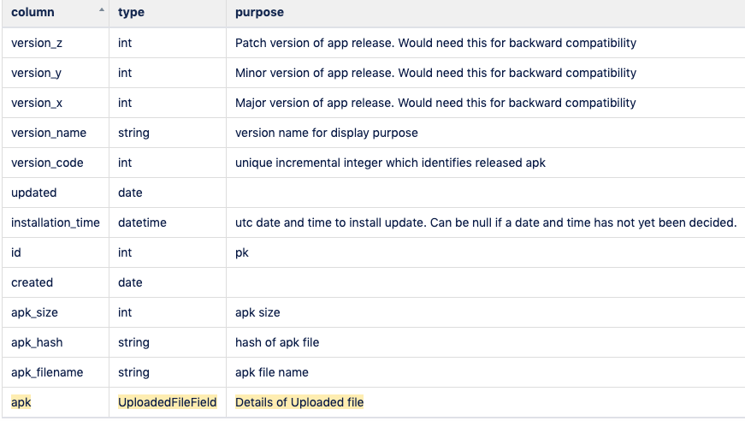
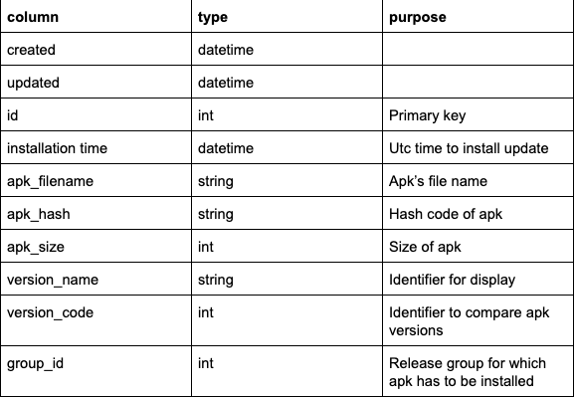
Database Schema
Previous Schema
New Schema

Slide 7
KokoPoint, Launcher and Airdroid APK
/kp/fuel-points/update-available
/kp/fuel-points/download-app
kp/fuel-points/scheduled-upgrade-time/<version_number>
Previously(v2)
Payload:
installedOSVersion
installedAppVersion(version_name)
apk_type
Updated(v3)
Payload:
installedAppVersion(version_code)
apk_type
Previously(v2)
Payload:
installedOSVersion
installedAppVersion(version_name)
apk_type
Updated(v3)
Payload:
installedAppVersion(version_code)
apk_type
Previously(v2)
Payload:
apk_type
Updated(v3)
Endpoint:
/fuel-points/scheduled-upgrade-time/<version_code>
Payload:
apk_type

Slide 8
STS
/sts/update-available
/sts/download-app
/sts/scheduled-upgrade-time/<version_number>
Previously(v2)
Payload:
installedOSVersion
installedAppVersion(version_name)
apk_type
Updated(v3)
Payload:
installedAppVersion(version_code)
apk_type
Previously(v2)
Payload:
installedOSVersion
installedAppVersion(version_name)
apk_type
Updated(v3)
Payload:
installedAppVersion(version_code)
apk_type
Previously(v2)
Payload:
apk_type
Updated(v3)
Endpoint:
/fuel-points/scheduled-upgrade-time/<version_code>
Payload:
apk_type

Slide 9
SDS
/sds/update-available
/sds/download-app
/sds/scheduled-upgrade-time/<version_number>
Previously(v2)
Payload:
installedOSVersion
installedAppVersion(version_name)
apk_type
Updated(v3)
Payload:
installedAppVersion(version_code)
apk_type
Previously(v2)
Payload:
installedOSVersion
installedAppVersion(version_name)
apk_type
Updated(v3)
Payload:
installedAppVersion(version_code)
apk_type
Previously(v2)
Payload:
apk_type
Updated(v3)
Endpoint:
/fuel-points/scheduled-upgrade-time/<version_code>
Payload:
apk_type

